Slide 1


Accident Detection and Prevention System
Presented by:
S.GUGANESH RAJ - 510920106006
N.ADITHYA - 510920106001
I.JAYALAKSHMI - 510920106007
S.SRIDHAR - 510920106305
B.E.ELECTRONICS AND COMMUNICATION ENGINEERING
Guided By:
Dr . S. Chandru M.E., PhD,
Assistant Professor / Head Of Department,
Department of ECE

Slide 2
OVERVIEW
OBJECTIVE
ABSTRACT
LITERATURE SURVEY
EXISTING SYSTEM
PROPOSED SYSTEM
SYSTEM INTEGRATION
HARDWARE USED
ADVANTAGES
CIRUCIT DIAGRAM
RESULTS
CONCLUSION
REFRENCES

Slide 3
OBJECTIVE
The objective of this project is to design and implement a smart accident detection system using Internet of Things (IoT) technology and GSM communication.
The system aims to automatically detect accidents using sensors installed in vehicles and promptly send alert messages containing the accident location to authorized personnel.
By leveraging IoT modules for car location and GSM communication for disseminating accident information, the system aims to provide timely assistance and support to accident victims, potentially saving lives in densely populated areas with inadequate emergency services.
The project involves the practical design, simulation, and validation of the proposed system using hardware components to ensure its effectiveness and reliability in real-world scenarios.

Slide 4
ABSTRACT
People lose their lives every day in countries with dense populations as a result of accidents and inadequate emergency services. If medical facilities had been available when they were needed, these lives might have been saved. Systems that automatically identify accidents are known as smart accident detection systems. The Internet of Things (IoT) allows for the connection of various devices, particularly sensors, and the use of information from sensors to carry out procedures that enable the identification of accidents; The most recent techniques for accident detection utilizing IoT technology are examined in this study, and then barriers, difficulties, and potential future trends are examined and contrasted. This project suggests a method that addresses this issue. Immediately when a car collides with an accident, a sensor will detect the signal and send it to the Arduino microcontroller. A microcontroller will send a output alert message through a GSM modem which is in build IOT device which will send an alert message with the recipient's location, and authorization So, after obtaining the information, the authorised person instantly uses the IOT modem to determine the location. The proposed systems have been practically designed and simulated using hardware components, and the outcomes meet expectations. The purpose of the system is to offer information regarding the accident's cause and location. It is beneficial to be able to quickly offer assistance and assistance to the accident victim. The IOT module in this system is used to locate the car. To disseminate accident information, GSM is employed.
Keywords - Accident detection, Alert system, GPS, GSM, IoT, MEMS, Android Application.

Slide 5
LITERATURE SURVEY
SI.NO | TITLE | JOURNAL NAME | AUTHOR | YEAR OF PUBLICATION | TECHNIQUES USED | DRAWBACKS
1 | Predictive Analytics of Road Accidents Using Machine Learning. | IEEE 2nd International Conference on Advance Computing and Innovative Technologies in Engineering (ICACITE) | C Kaliraja, D Chitradevi, Anju Rajan | 2022 | A machine-learning approach in terms of considering factors like the number of accidents in a year, month, state, etc. is considered and used improve the safety measures. | the possibility of the model relying too heavily on historical data, which might not reflect current or emerging trends in accidents. This could result in ineffective safety measures that fail to address new challenges or changing road conditions.
2 | Car Accident Prevention and Health Monitoring System for Drivers. | IEEE Region 10 Symposium (TENSYMP) | Md. Hasibul T. M. Safi Sami; | 2021 | In this proposal, the health monitoring sensors are used to monitor the health of the driver and the movement of the vehicle. | A drawback of using health monitoring sensors to track both the driver's health and vehicle movement is the potential for privacy concerns regarding the collection and storage of personal health data.

Slide 6
SI.NO | TITLE | JOURNAL NAME | AUTHOR | YEAR OF PUBLICATION | TECHNQUES USED | DRAWBACKS
3 | A Road Accident Prediction Model Using Data Mining Techniques. | IEEE 5th International Conference on Computing Methodologies and Communication (ICCMC) | Preethi K; Nandini R; | 2021 | An accident prediction model is created using the Apriori algorithm and vector machines as part of a data mining technique to prevent accidents. | a drawback of using the Apriori algorithm and support vector machines for accident prediction is the potential complexity of integrating these techniques, along with the reliance on historical data patterns, which may not always reflect dynamic road conditions or emerging accident trends.
4 | Accident Detection and Warning System. | IEEE Asian Conference on Innovation in Technology (ASIANCON) | Akash Bhakat, V Vijayasherly | 2021 | CCTV cameras are enhanced with night vision that captures the video and produces the realtime signals that are used to detect the accident. | Even with night vision enhancements, a potential drawback of using CCTV cameras for accident detection is their limited effectiveness in extreme weather conditions.

Slide 7
SI.NO | TITLE | JOURNAL NAME | AUTHOR | YEAR OF PUBLICATION | TECHNIQUES USED | DRAWBACKS
5 | Prototype Proposal for Quick Accident Detection and Response System (QARS). | IEEE International Conference on Research in Computational Intelligence and Communication Networks (ICRCICN) | Sonjoy Rana, Sourav Jana, Rahul Dan | 2020 | In order to develop QARS with the help of the Internet of Things, we acquired the information using the GPS and GSM communication | The system's reliability and accuracy heavily rely on consistent GPS and GSM network coverage. In areas with poor signal reception or network outages, the system may experience data acquisition failures or delays, compromising its effectiveness in monitoring and ensuring quality and reliability in real-time.
6 | Accident Detection Using Convolutional Neural Networks. | IEEE International Conference on Data Science & Communication (IconDSC) | Sreyan Ghosh; Sherwin Joseph Sunny, Rohan Roney | 2019 | CCTV cameras on highways are used through a deep learning convolution neural network model for accident detection. | the dependency on clear camera views and lighting conditions, as poor visibility or camera obstructions may hinder the accuracy of accident detection, reducing the system's reliability in adverse weather or low-light environments.

Slide 8
SI.NO | TITLE | JOURNAL NAME | AUTHOR | YEAR OF PUBLICATION | TECHNIQUES USED | DRAWBACKS
7 | Improving Estimation of Vehicle's Trajectory Using the Latest Global Positioning System with Kalman Filtering. | IEEE Transactions on Instrumentation and Measurement | Cesar Barrios, Yuichi Motai | 2011 | It proposes the Kalman filters and the "interacting multiple model" be used to provide the future location of the automobile. | A potential drawback of using Kalman filters and "interacting multiple model" techniques for predicting the future location of automobiles is their complexity and computational overhead.
8 | Ubiquitous GPS vehicle tracking and management system. | IEEE Jodan Conference on Applied Electrical Engineering and Computing Technologies (AEECT) | Iman Almomani Nour Y. Alkhalil Enas M. Ahmad Rania M. Jodeh., | 2011 | It provides a vehicle tracking system through the GPS, GPRS, and GSM communication networks. | A concise drawback of vehicle tracking systems using GPS, GPRS, and GSM networks is their vulnerability to communication breakdowns and inaccuracies due to limited network coverage.

Slide 9
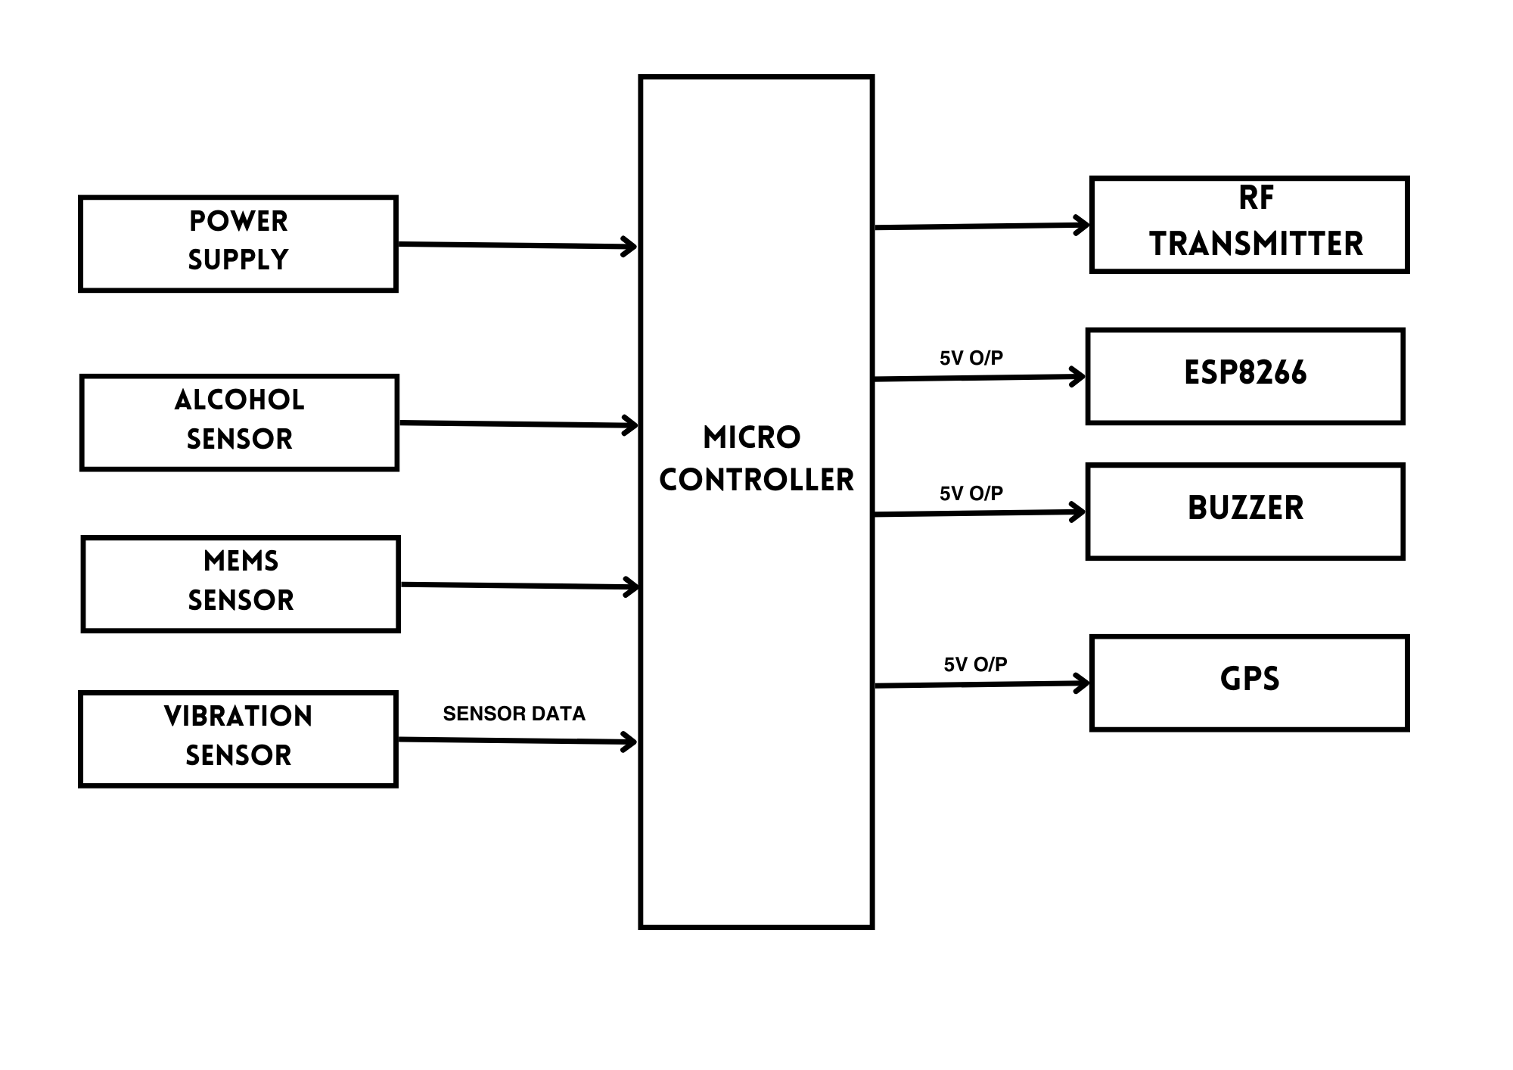
EXISTING SYSTEM
DRAWBACK WITH EXISTING ARCHITECTURE:
Limited Sensor Coverage
Alert System Limitations
Performance Constraints
RF Transmitter Range Limitations
Unnecessary Alerts

Slide 10
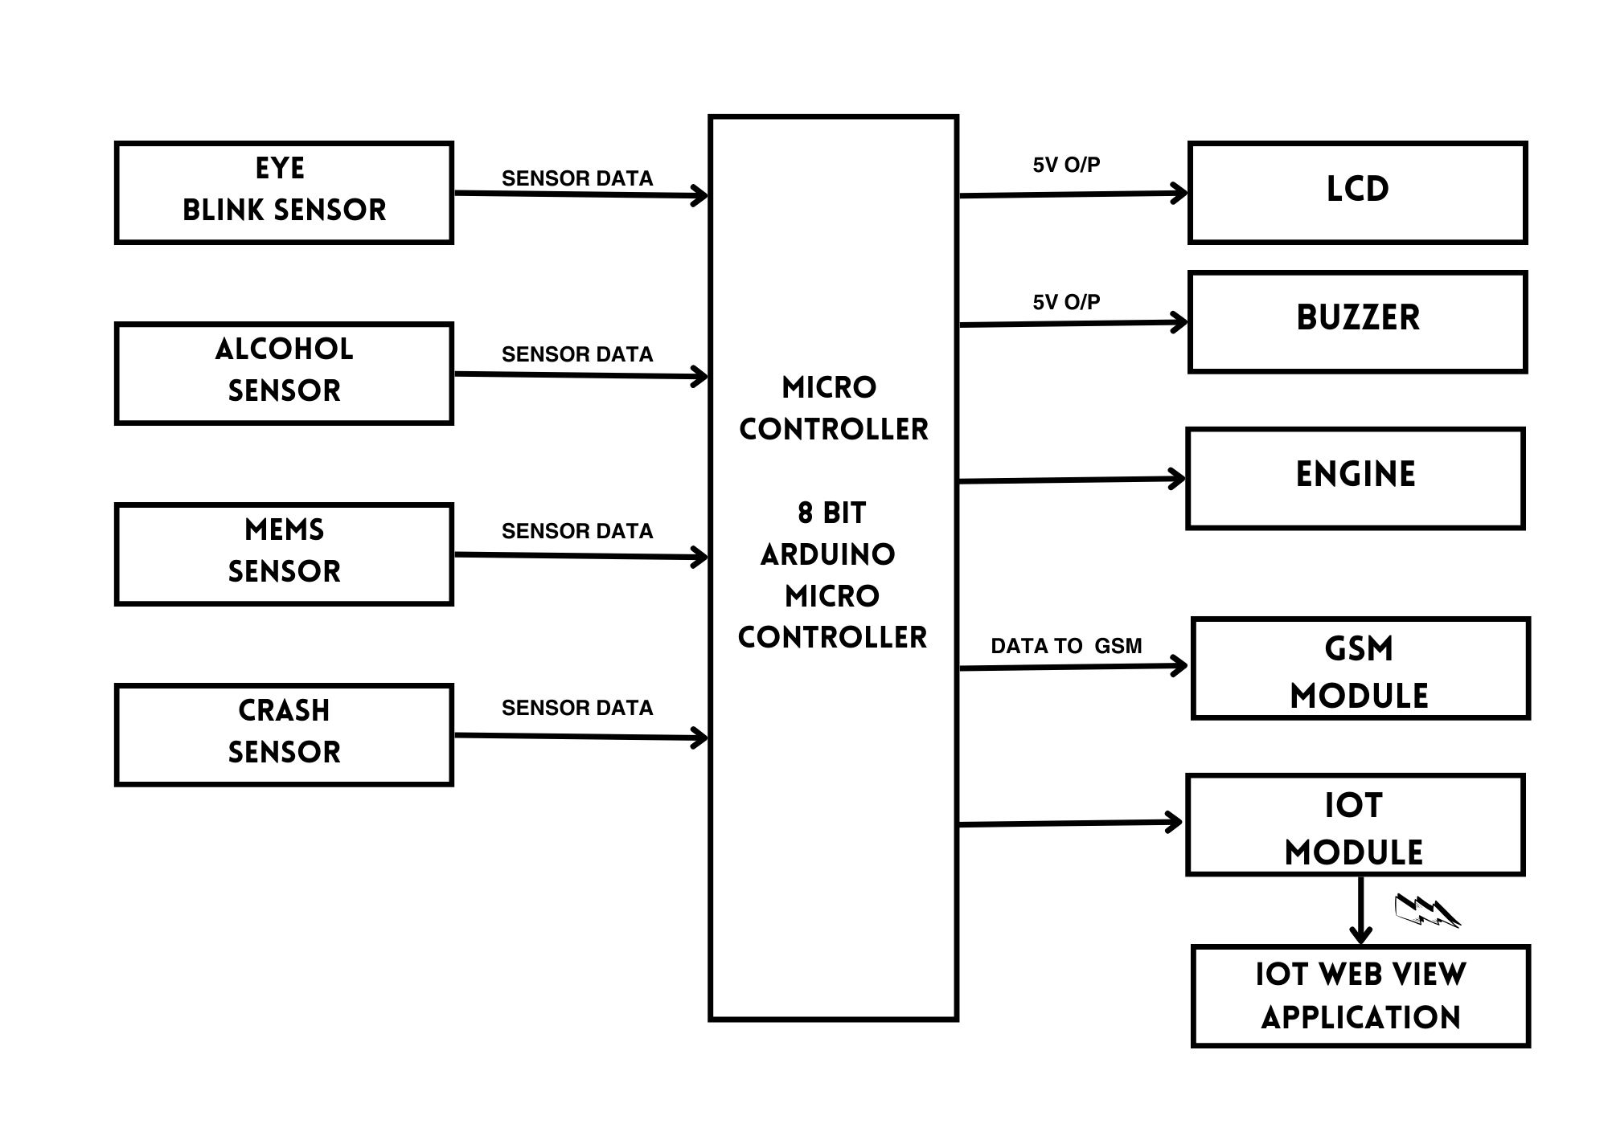
BLOCK DIAGRAM OF PROPOSED SYSTEM

Slide 11
SYSTEM INTEGRATION
HARDWARE REQUIRMENTS
ARDUINO UNO
EYEBLINK SENSOR
ALCOHOL SENSOR
MEMS SENSOR
CRASH SENSOR
GSM MODULE
GPS MODULE
IOT MODULE
LCD
BUZZER
POWER SUPPLY
SOFTWARE REQUIRMENTS
1.EMBEDDED C
2.ARDUINO IDE

Slide 12
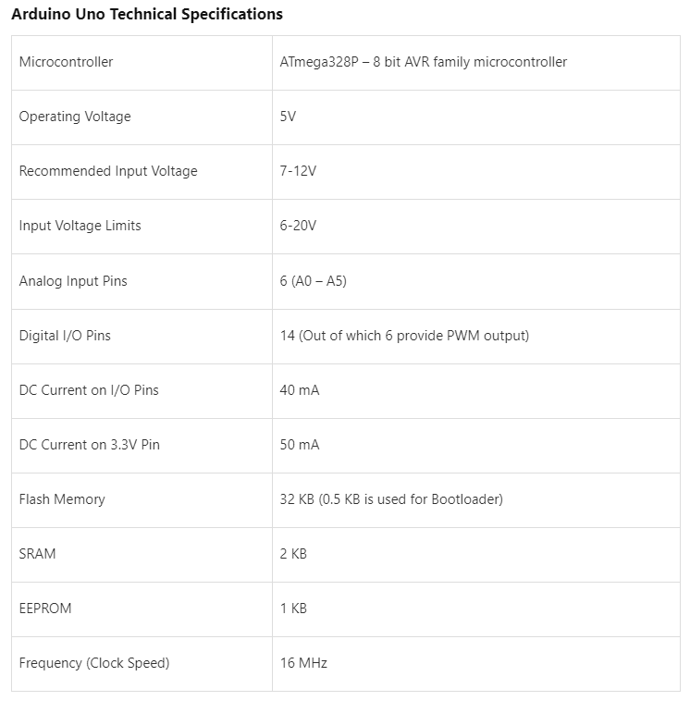
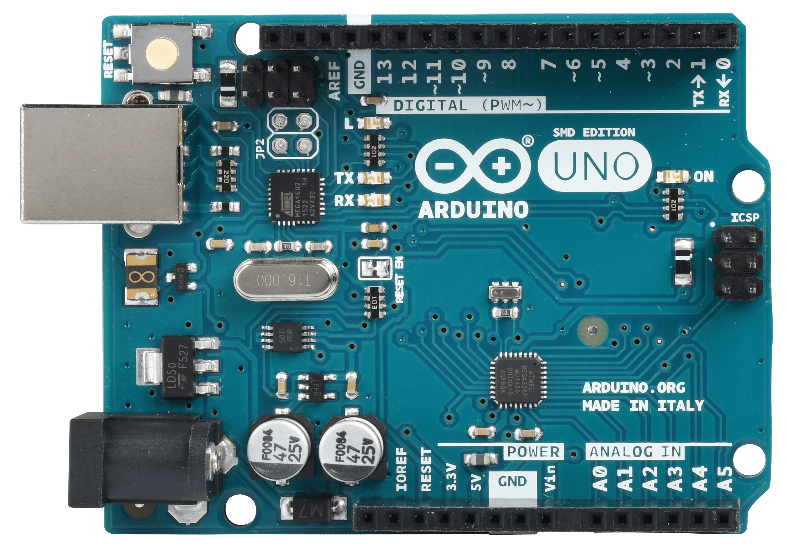
HARDWARE USED
Arduino Microcontroller
1.Arduino microcontrollers generate control signals to interact with external components such as LEDs, motors, servos, and relays. These signals can be digital (on/off) or analog (variable voltage levels), allowing precise control over connected devices.
2.Arduino boards read data from various sensors, including temperature, humidity, light, motion, and environmental sensors. These sensor readings provide valuable input for monitoring the physical environment, detecting changes, and triggering actions or responses.
3. Arduino boards support various communication protocols, including serial, I2C, SPI, and Ethernet, allowing them to communicate with other devices, sensors, or computers. Arduino projects can send and receive data over wired or wireless connections, enabling remote monitoring, control, and data exchange.
The Arduino microcontroller is a popular open-source hardware platform widely used for prototyping and DIY electronics projects. Based on simple-to-use hardware and software, Arduino enables enthusiasts, hobbyists, and professionals to create a wide range of interactive electronic devices and prototypes.

Slide 13
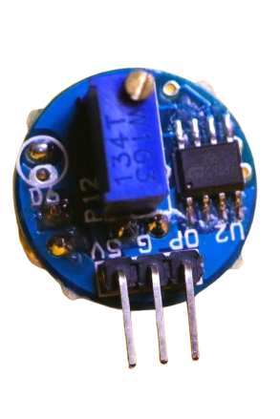
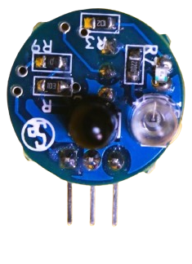
HARDWARE USED
Eyeblink Sensor
Eye Blink Sensor (EBS) that will sense and alert the driver in drowsiness. A sensor for monitoring eye movements would be useful in warning drivers when they fall asleep. The driver’s eye is continuously monitored using an IR sensor. The normal eye blink rate will have no effect on the output of the system. If Driver fell asleep, then IR sensor receives abnormal blinking rate & an alarm will ring, to wake him/her up. The sensor part of the EBM system is implemented as a goggle. This goggle is to be worn by the driver while driving the vehicle.

Slide 14
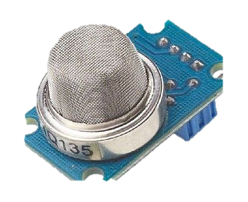
HARDWARE USED
ALCOHOL SENSOR
MQ-3 module is suitable for detecting Alcohol, Benzine, CH4, Hexane, LPG.Sensitive material of MQ-3 gas sensor is SnO2, which with lower conductivity in clean air. When the target alcohol gas exists, the sensor’s conductivity is more higher along with the gas concentration rising. MQ 3 gas sensor has high sensitivity to Alcohol, and has good resistance to disturb of gasoline, smoke and vapor. This sensor provides an analog resistive output based on alcohol concentration. When the alcohol gas exists, the sensor’s conductivity gets higher along with the gas concentration rising.
1.When the circuit is switched on, following message appears on the LCD screen – “ARE U ALCOHOL FREE”
2.The user blows through the MQ-3 sensor provided with the system.
3.When the user is drunk, then the system will display following message – “Drunken & Driving !!!” and the buzzer sound an alarm.
4.Along with this buzzer, the user’s vehicle stops and the buzzer stops sounding.

Slide 15
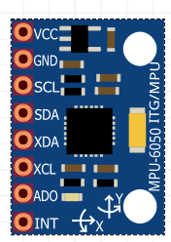
HARDWARE USED
MEMS SENSOR
The MEMS (Microelectromechanical Systems) sensor is a sophisticated device integrated with tiny mechanical and electrical components fabricated on a single chip. It comprises various modules such as accelerometers, gyroscopes, and magnetometers, each serving specific sensing functions. MEMS sensors find extensive applications in diverse fields, including automotive, consumer electronics, and healthcare, due to their compact size, low power consumption, and high precision.

Slide 16
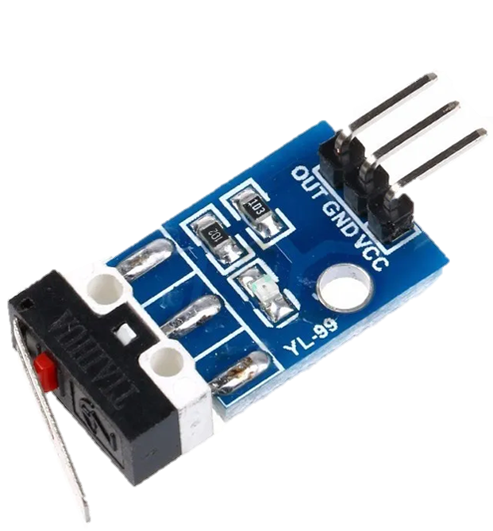
HARDWARE USED
Crash Sensor
A crash sensor, also known as an impact sensor or collision sensor, is a vital component in vehicle safety systems designed to detect and respond to collisions or accidents. These sensors are crucial for deploying safety features such as airbags and activating emergency response systems in the event of a crash. By rapidly detecting sudden changes in acceleration or deceleration, crash sensors play a critical role in mitigating the impact of accidents and protecting vehicle occupants from injury.

Slide 17
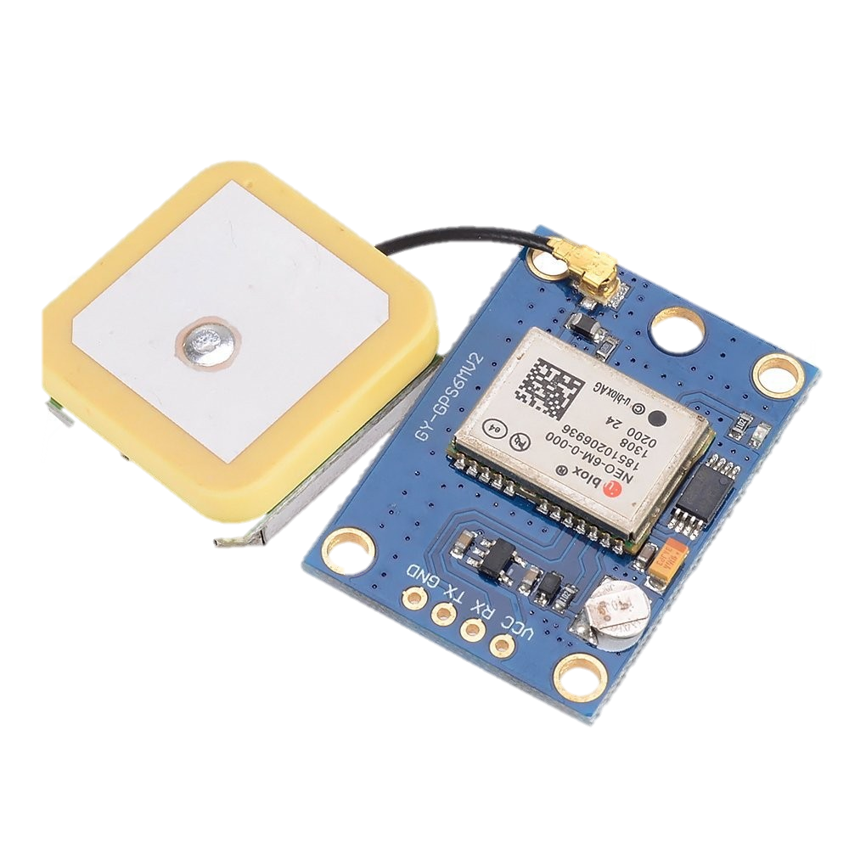
HARDWARE USED
GPS MODULE
GPS (Global Positioning System) is a satellite-based navigation system widely used for determining accurate position, velocity, and time information anywhere on Earth. Comprising a network of satellites orbiting the planet, GPS receivers on Earth communicate with these satellites to calculate precise geographic coordinates. Originally developed for military purposes, GPS has become an essential technology in various civilian applications, including navigation, mapping, surveying, and location-based services.

Slide 18
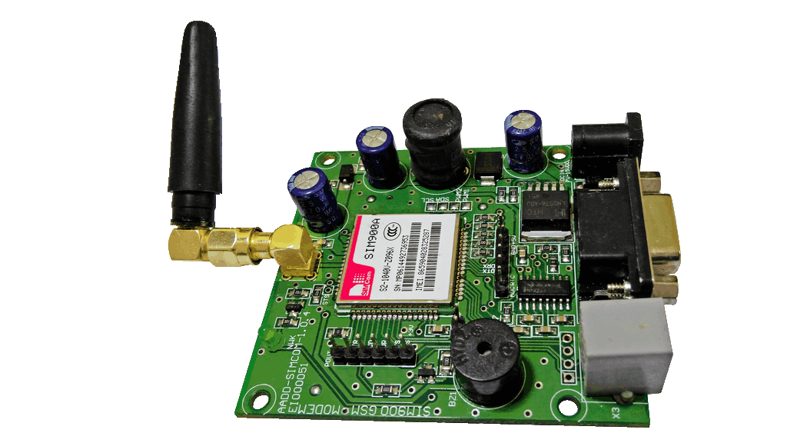
HARDWARE USED
GSM MODULE
GSM (Global System for Mobile Communications) is a widely used standard for digital cellular networks that enables mobile communication services, including voice calls, text messaging (SMS), and data transmission. Originally introduced as a second-generation (2G) technology, GSM has evolved to support higher data speeds and advanced features, making it a foundational technology for mobile telecommunication networks worldwide.

Slide 19
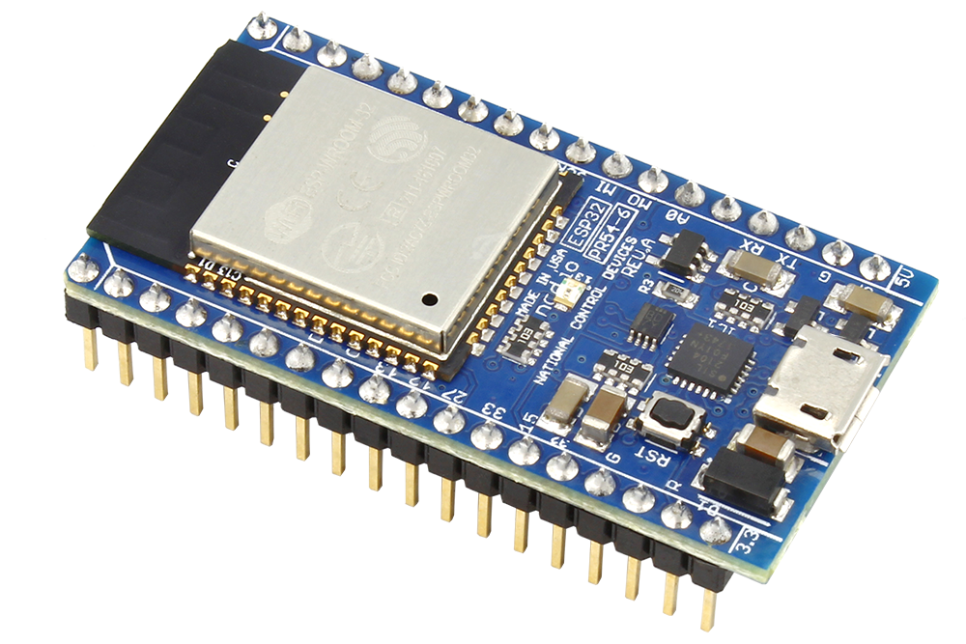
HARDWARE USED
IoT Module
An IoT (Internet of Things) module is a hardware component that enables devices to connect to the internet and exchange data with other devices or cloud-based platforms. These modules typically integrate wireless communication protocols, such as Wi-Fi, Bluetooth, or cellular connectivity, allowing devices to transmit and receive data remotely. IoT modules play a crucial role in enabling the deployment of IoT solutions across various industries, enabling remote monitoring, control, and automation of connected devices and systems.

Slide 20
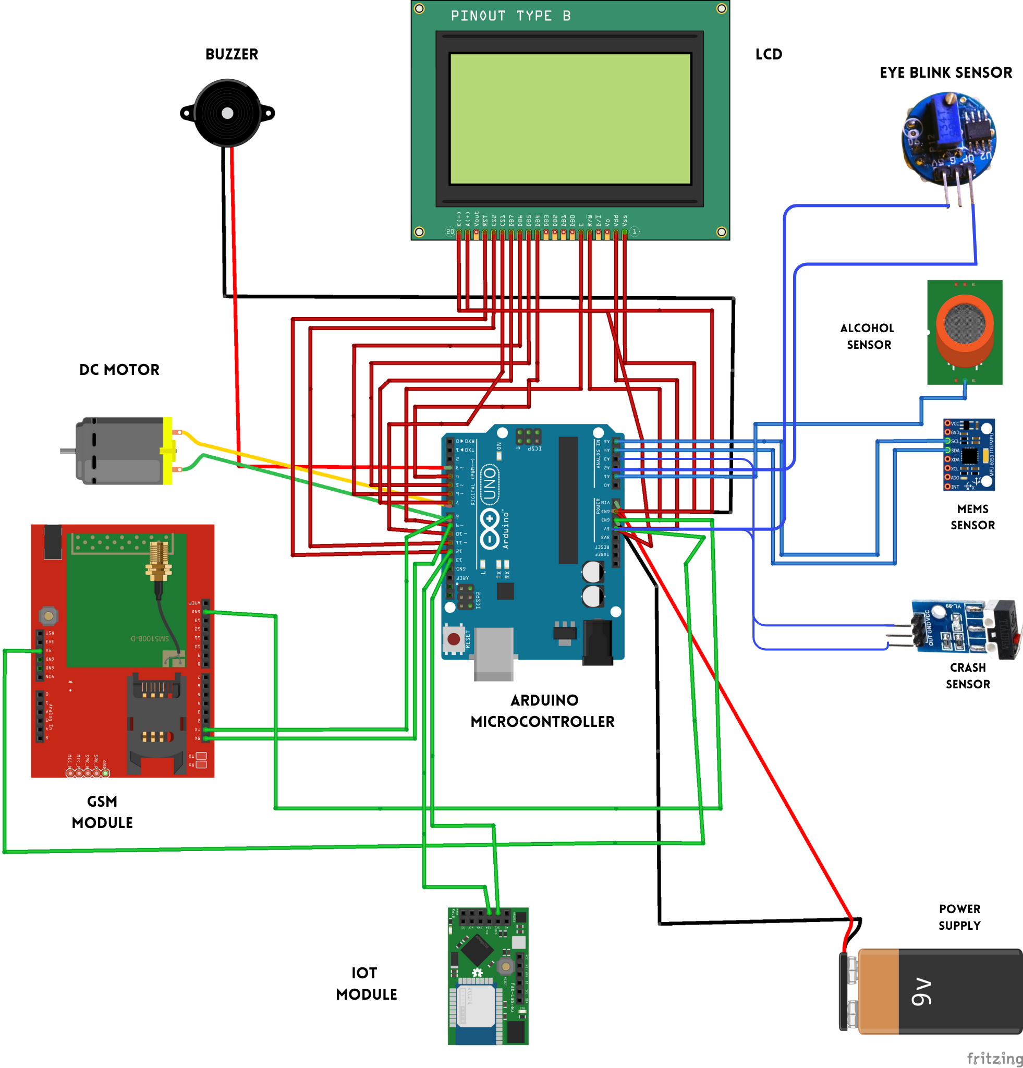
CIRCUIT DIAGRAM

Slide 21
PROPOSED SYSTEM
ADVANTAGE OF PROPOSED ARCHITECTURE:
Enhanced accuracy with Eyeblink Sensor and Alcohol Sensor
Improved accident detection with MEMS Accelerometer and Crush Sensor.
Advanced control with Microcontroller (8-bit Arduino Microcontroller).
Real-time feedback and situational awareness with LCD and Buzzer.
Active safety measures enabled by GSM and GPS
Seamless connectivity and data transmission facilitated by IoT Module.
User-friendly interface for monitoring and alerts with IoT Web View Application.

Slide 22

PROPOSED SYSTEM

Slide 23
RESULTS AND OUTPUT

Slide 24
RESULTS AND OUTPUT

Slide 25
RESULTS AND OUTPUT
HOME PAGE OF IoT WEB APPLICATION

Slide 26
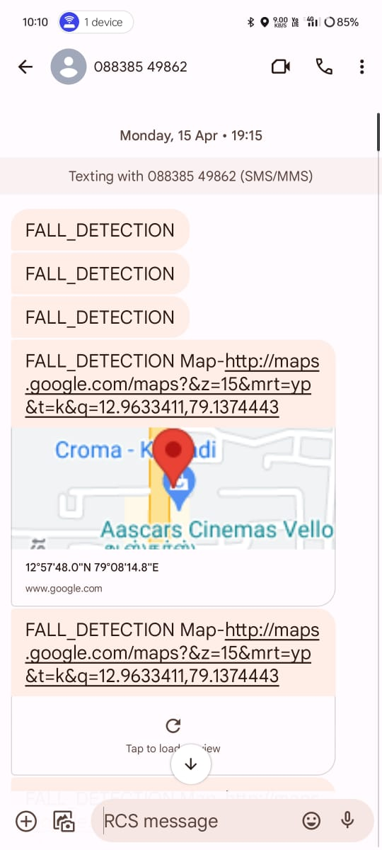
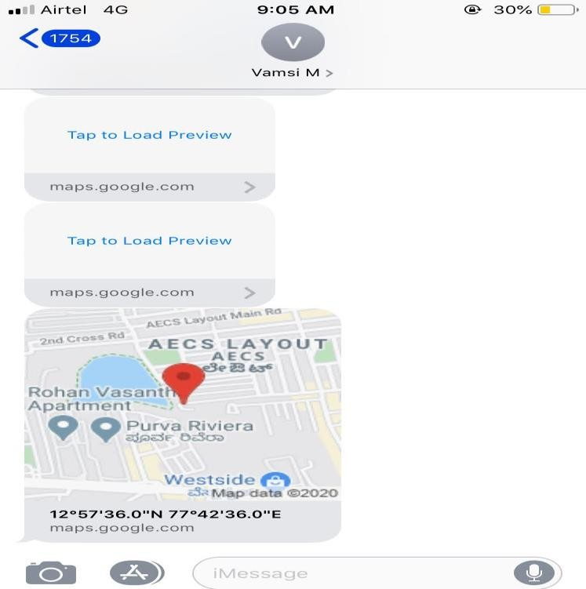
RESULTS AND OUTPUT

Slide 27
FUTURE SCOPE
1. Integration with Autonomous Vehicles Expand integration with self-driving cars for enhanced safety.
2. Smart City Integration Extend to communicate with smart city infrastructure for optimized traffic flow and emergency response.
3. Predictive Analytics Utilize data analytics to predict accidents and implement proactive safety measures.
4. Advanced Sensor Technology Incorporate advanced sensors for improved accident detection accuracy.

Slide 28
COCLUSION
1. Promising Solution: The development of a smart accident detection system using IoT technology offers a promising solution for timely response to accidents in densely populated areas.
2. Seamless Integration:Through the integration of sensors, microcontrollers, and GSM modems, the system enables swift detection of accidents and dissemination of critical information to authorized personnel.
3. Validation through Design and Simulation: Practical design and simulation efforts have validated the system's effectiveness, demonstrating its potential to provide rapid assistance and support to accident victims, potentially saving lives.
4. Potential for Rapid Assistance: The system's effectiveness highlights its potential to offer rapid assistance and support to accident victims by promptly providing location data to authorized personnel.
5. Continued Evolution: As IoT technology continues to evolve, further enhancements to scalability, reliability, and interoperability will ensure the system's continued effectiveness in addressing emergency response challenges.
6. Transformative Impact: This project underscores the transformative impact of IoT technology in revolutionizing emergency services, emphasizing the importance of innovation in saving lives and mitigating the impact of accidents in communities.

Slide 29
REFERENCES
[1] Ahmed, V., & Jawarkar, N. P. (2013). Design of Low Cost Versatile Microcontroller Based System Using Cell Phone for Accident Detection and Prevention. In 2013 6th International Conference on Emerging Trends in Engineering and Technology (pp. 73–77). https://doi.org/10.1109/ICETET.2013.17
[2] Alvi, U., Khattak, M., Shabir, B., Malik, A., & Ramzan, M. S. (2020). A Comprehensive Study on IoT Based Accident Detection Systems for Smart Vehicles. IEEE Access, PP, 1–1.https://doi.org/10.1109/ACCESS.2020.3006887
[3] Altameem, A., Kumar, A., Poonia, R. C., Kumar, S., & Saudagar, A. K. J. (2021). Early Identification and Detection of Driver Drowsiness by Hybrid Machine Learning. IEEE Access, 9, 162805–162819. https://doi.org/10.1109/ACCESS.2021.3131601
[4] Dogru, N., & Subasi, A. (2018). Traffic accident detection using random forest classifier. In 2018 15th Learning and Technology Conference (L&T) (pp. 40–45). https://doi.org/10.1109/LT.2018.8368509
[5] Ezzouhri, A., Charouh, Z., Ghogho, M., & Guennoun, Z. (2021). Robust Deep Learning-Based Driver Distraction Detection and Classification. IEEE Access, 9, 168080–168092. https://doi.org/10.1109/ACCESS.2021.3133797

Slide 30
REFERENCES
[6] Fernandez, S., Ito, T., Cruz-Piris, L., & Marsa-Maestre, I. (2022). Fuzzy Ontology-Based System for Driver Behavior Classification. Sensors, 22(20), Art. no. 20. https://doi.org/10.3390/s22207954
[7] Karthikeyan, S., Kiruthik, J., Madumitha, S., Manikandan, R., & Prakash Raj, V. (2023). Design and Implementation of IoT Based Accident Detection and Prevention System. IEEE. https://doi.org/10.1109/ICOEI56765.2023.10125826
[8] Kim, K. G. (2016). Book Review: Deep Learning. Healthc Inform Res, 22(4), 351. https://doi.org/10.4258/hir.2016.22.4.351
[9] Kinage, V., & Patil, P. (2019). IoT Based Intelligent System For Vehicle Accident Prevention And Detection At Real Time. In 2019 Third International conference on ISMAC (IoT in Social, Mobile, Analytics and Cloud) (I-SMAC) (pp. 409–413). https://doi.org/10.1109/I-SMAC47947.2019.9032662
[10] Mohanta, B. K., Jena, D., Mohapatra, N., Ramasubbareddy, S., & Rawal, B. S. (2022). Machine learning based accident prediction in secure IoT enable transportation system. IFS, 42(2), 713–725. https://doi.org/10.3233/JIFS-189743

Slide 31
ANY QUERIES?????

Slide 32
THANK YOU

